Slide 1

Welcome to
Structuring DL projects & hyperparameter tuning
By: Ahmed Haytham
2022-2023

Slide 2
What is a good architecture to start with?
How many hidden layers should you stack?
How many hidden units or filters should go in each layer?
What is the learning rate?
Which activation function should you use?
Which yields better results, getting more data or tuning hyperparameters?
Performance & Data

Slide 3
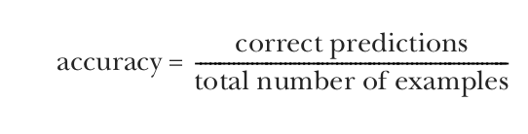
Defining performance metrics
Performance metrics allow us to evaluate our system.
Ex:Imbalance Disease

Slide 4
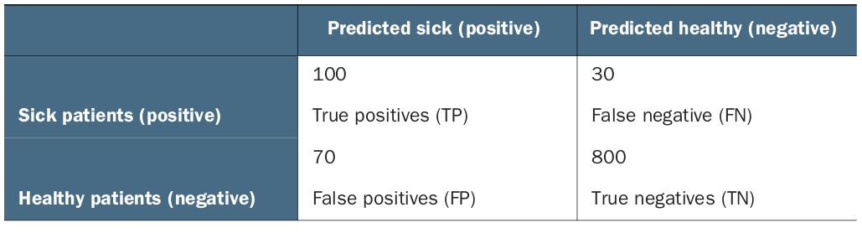
Confusion matrix
Disease
YES
NO
The goal is to describe model performance from different angles other than prediction accuracy
True positives (TP)—The model correctly predicted yes (the patient has the disease).
True negatives (TN)—The model correctly predicted no (the patient does not have the disease).
False positives (FP)—The model falsely predicted yes, but the patient actually does not have the disease Type 1
False negatives (FN)—The model falsely predicted no, but the patient actually does have the disease Type 2

Slide 5
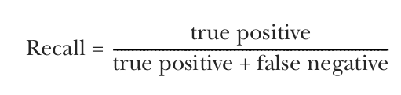
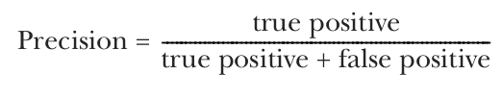
Confusion matrix
Recall (also known as sensitivity) tells us how many of the sick patients our model incorrectly diagnosed as well.
Precision ((also known as specificity) is the opposite of recall. It tells us how many of the well patients our model incorrectly diagnosed as sick

Slide 6
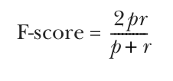
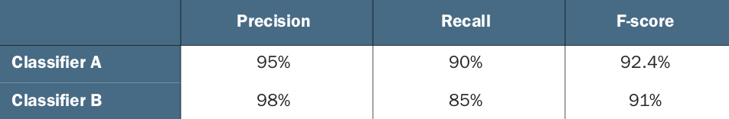
Confusion matrix
F-score gives a good overall representation of how your model is performing. Let’s take a look at the health-diagnostics example again.

Slide 7
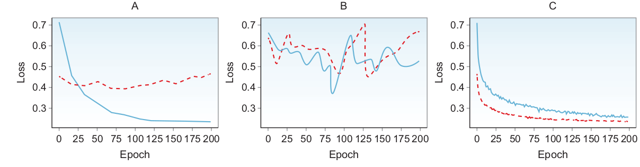
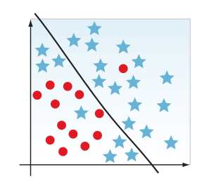
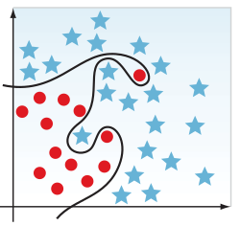
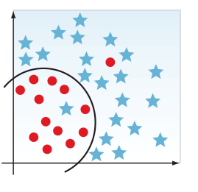
Evaluating the model and interpreting its performance
Underfitting means the model is too simple
Overfitting is when the model is too complex
We want to build a model that is just right for the data: not too complex, causing
overfit, or too simple, causing underfit

Slide 8
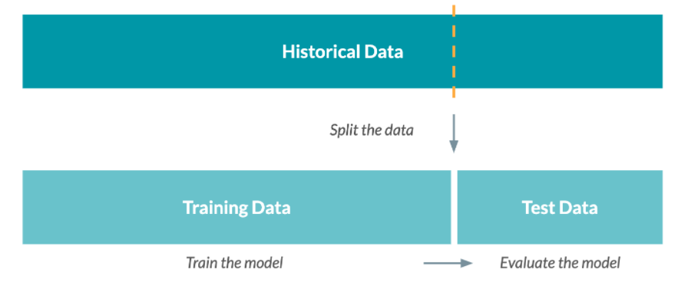
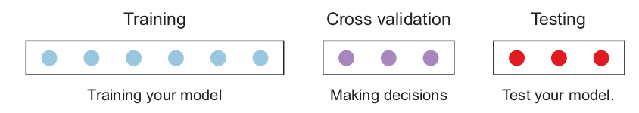
Data
Splitting your data for train/validation/test

Slide 9
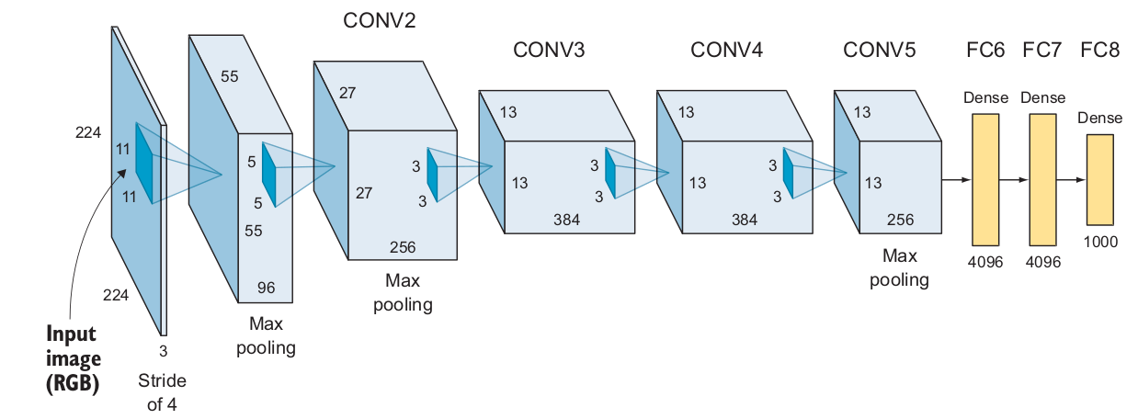
Designing a baseline model
Should I use an MLP or CNN network ?
Should I use other object detection techniques like YOLO or SSD ?
How deep should my network be?
Which activation type will I use?
What kind of optimizer do I use?
Do I need to add any other regularization layers like dropout or batch normalization to avoid overfitting?

Slide 10
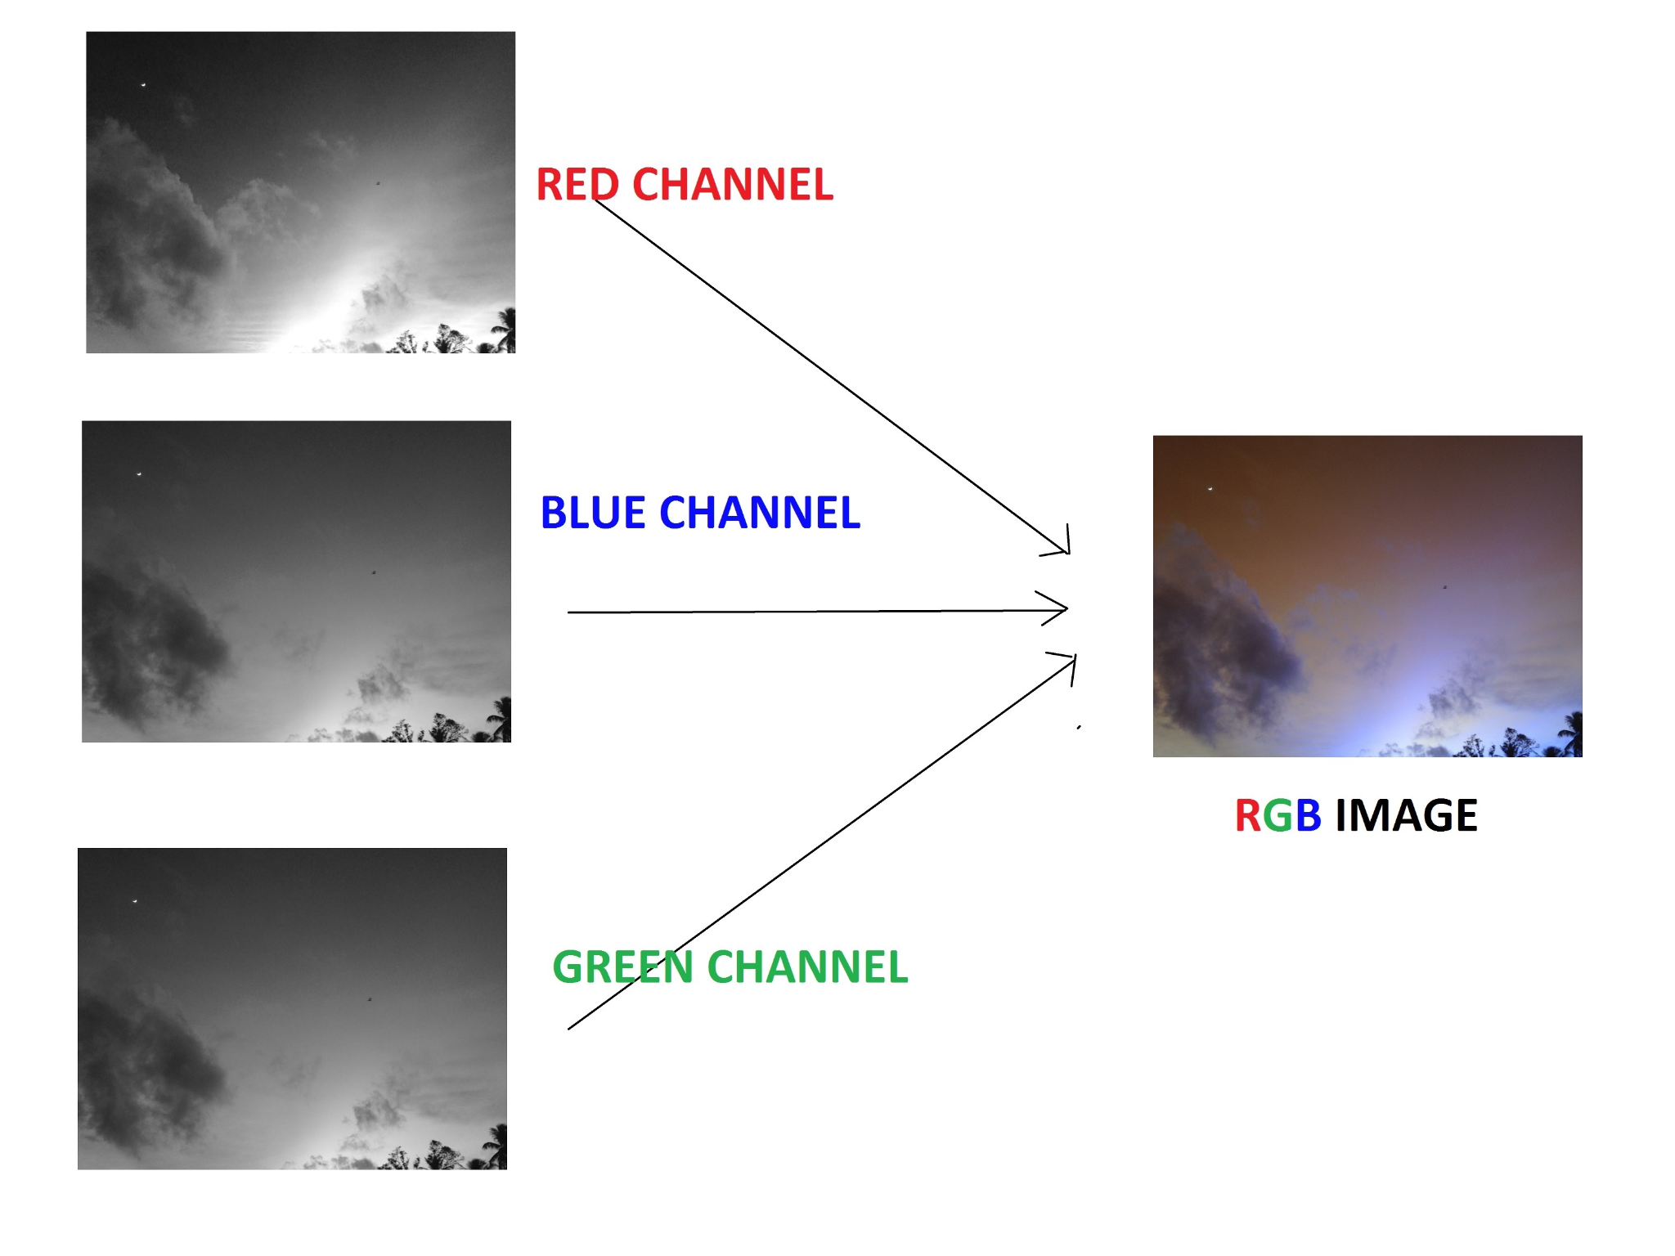
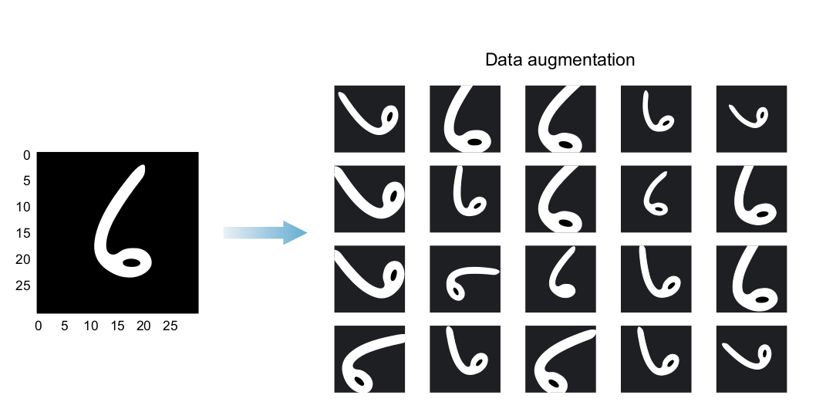
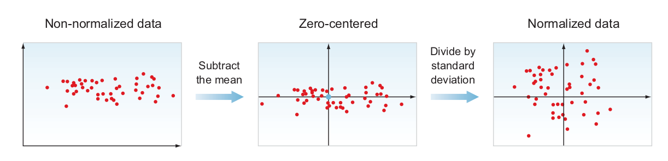
Data
IMAGE GRAY-SCALING
IMAGE RESIZING
DATA NORMALIZATION
Small values : make all range between [0,1,]
Homgunoes : All pixels should have values in the same range
IMAGE AUGMENTATION

Slide 11
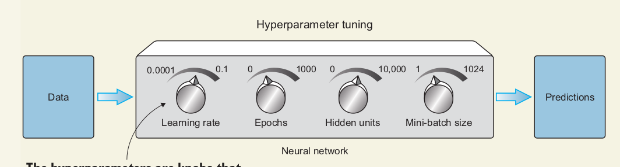
Improving the network and tuning hyperparameters
Collecting more data vs. tuning hyperparameters
Parameters vs. hyperparameters
Parameters
the variables that the network updates with no direct manipulation from us
Hyper_Parameters
that are not learned by the network
EX:learning rate, batch size, number of epochs

Slide 12
Improving the network and tuning hyperparameters
Neural network hyperparameters
Network architecture
Number of hidden layers (network depth)
Number of neurons in each layer (layer width)
Activation type
Learning and optimization
Learning rate and decay schedule
Mini-batch size
Optimization algorithms
Number of training iterations or epochs (and early stopping criteria)
Regularization techniques to avoid overfitting
L2 regularization
Dropout layers
Data augmentation

Slide 13
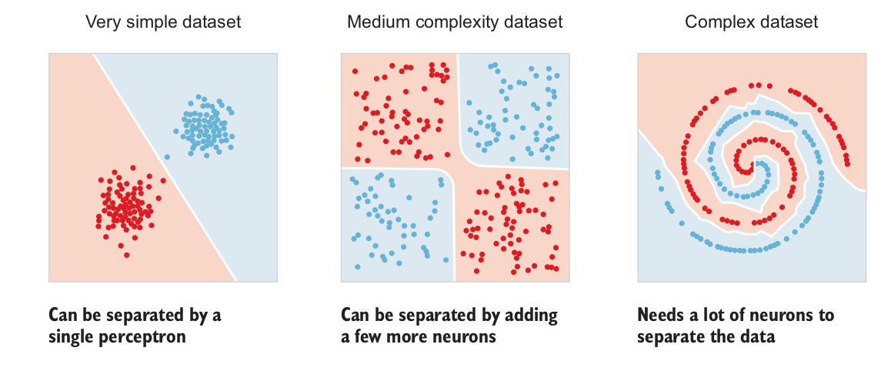
Improving the network and tuning hyperparameters
Network architecture
Whether you are designing an MLP, CNN, RNN, or other neural network, you need to decide on the number of hidden layers in your network (depth) and the number of neurons in each layer (width)

Slide 14
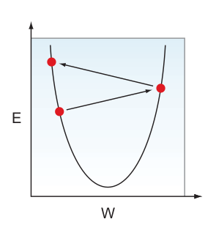
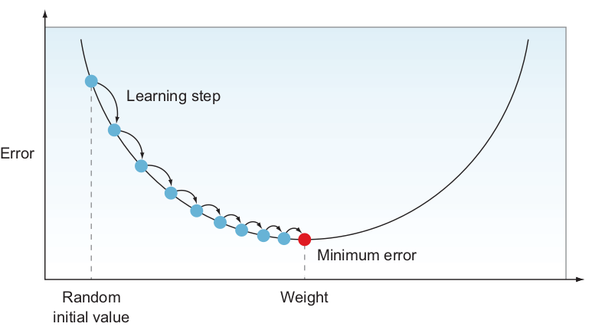
Improving the network and tuning hyperparameters
Learning and optimization
Now that we have built our network architecture, it is time to discuss the hyperparameters that determine how the network learns and optimize its parameter to achieve the minimum error
Learning rate and decay schedule

Slide 15
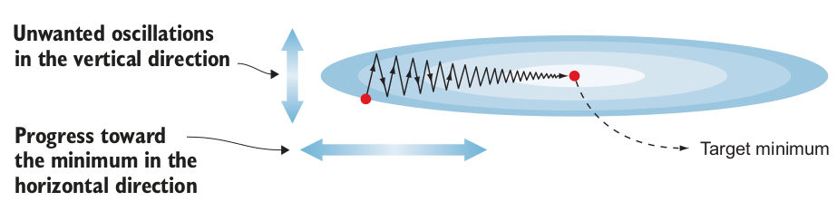
Improving the network and tuning hyperparameters
Optimization algorithms
Gradient descent with momentum
Recall that SGD ends up with some oscillations in the vertical direction toward the minimum error

Slide 16
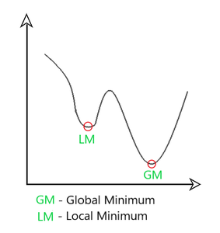
Improving the network and tuning hyperparameters
Optimization algorithms
Adam
Adam stands for Adaptive Moment Estimation. Adam keeps an exponentially decaying average of past gradients, similar to momentum
The authors of Adam propose these default values:
The learning rate needs to be tuned.
For the momentum term β1, a common choice is 0.9.
For the RMSprop term β 2, a common choice is 0.999.
ε is set to 10^–8.

Slide 17
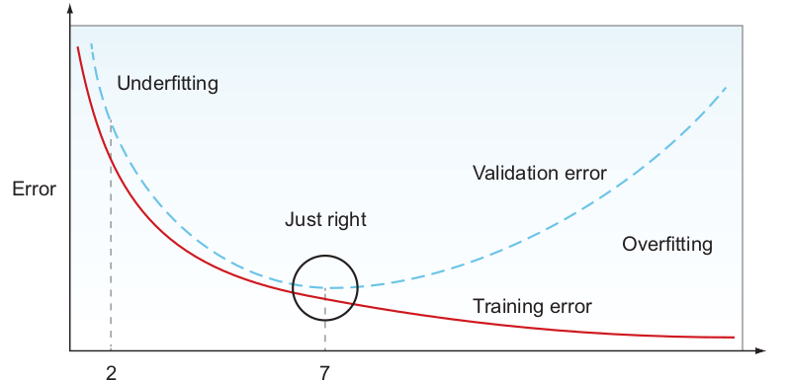
Improving the network and tuning hyperparameters
Number of epochs and early stopping criteria
A training iteration, or epoch, is when the model goes a full cycle and sees the entire training dataset at once.
Early stopping
monitor—The metric you monitor during training
min_delta—The minimum change that qualifies as an improvement
patience—This variable tells the algorithm how many epochs it should wait before stopping the training

Slide 18
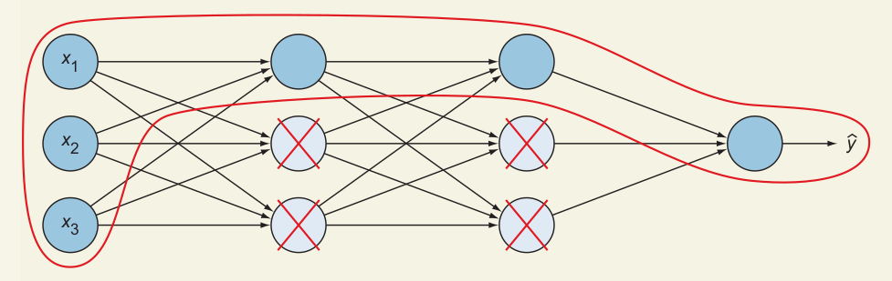
Everyone will learn
Dropout layers
Dropout is another regularization technique that is very effective for simplifying a neural network and avoiding overfitting

Slide 19

Thank you.
Very much!

